Slide 1
Home Equity Loans!
Why Cash Out? Why Now?
Why Spring EQ?

Slide 2
Email Your Questions to:
askspring@springeq.com

Slide 3
Home Equity Loans

Slide 4
Home Equity Loans
Home Equity Line of Credit (HELOC)
Home Equity Loan (HELOAN)
Adjustable Rate for Life of Loan
Rate Calculation = Index + Margin
Index is “US Prime Rate”
Published in The Wall Street Journal
Currently 6.25%
Margin is fixed for the life of loan
Fixed Rate Second Mortgage
Fully Amortizing
Terms from 5 years to 30 years
All funds given to the borrower at closing
No Prepayment Penalty
2nd lien position only
Lifetime Rate Cap – 18%
*Interest Only payment for the first 10 years
10-year draw period – use and reuse the funds during this period
Principal reduction payments will decrease the monthly payment
Additional draws will increase the monthly payment
Year 11 the line is closed, and no additional draws can be taken
Line enters repayment period – 20 years fully amortizing
but still variable rate
Notes:
There are 2 traditional types of Home Equity Loans.
The 1st is a Home Equity Line of Credit, commonly referred to and called a HELOC.
With HELOC’s, think of them like a credit card. The loan will have a limit – a maximum amount, called the Total Line amount or Max line amount, but you do not need to borrow the max, you can use the line of credit over time, borrower against it and pay it down, again, just like a credit card.
A HELOC is typically an adjustable rate - based on an index and a margin. The index can change, but the margin is set for the life of the loan. For Spring EQ HELOC’s, the index is The US Prime rate, typically just called PRIME.
With a Spring EQ HELOC, the loan is based on a 30 year total term – and also enjoys a 10 year draw period – meaning - for the 1st 10 years, the borrower can draw additional funds at any time as long as they have not hit the maximum line amount. During this 10 year draw period, the loans payments are based on an interest only payment, referred to as IO payments, so the minimum payment is an interest only payment and any addition payments goes to reduce the principle, opening up the available funds to borrower in the future during the first 10 years. Again, think of it like a credit card.
The 2nd most common Home Equity Loan is a closed ended, fixed 2nd mortgage, referred to as a HELOAN – Home Equity Loan
A HELOAN is a fixed rate, fully amortized loan with terms available from 5 to 30 years, in 5 year increments. Unlike a HELOC, a HELOAN has all funds disbursed at closing and there are no future draw options. This is a 1 time draw at time of closing/funding.

Slide 5
Home Equity Loans

Slide 6
Why Cash Out?
$29T
Total Available Equity

Slide 7
Why Cash Out?
Notes:
This chart generated by the St Louis Fed shows the total available homeowners’ equity, regardless of LTV going back to the 1950’s through the 2nd Quarter of this year, 2022. The gray shaded bars along the timeline represent periods of recessions, with the largest mark right around that 2007 era…the same era that we refer to as: The “mortgage meltdown”. Now since the meltdown and up to present day, equity has been on a steady climb, more than doubling over that time period.

Slide 8
Why Cash Out?
Notes:
Using data on prepay activity complied by Black Knight on 1st mortgage loans, you can see the height of refinances, especially rate and term’s represented by the blue bars in the graph, spiked during the early 2020’s and ran through about mid 2021.
But since mid 2021, you can see a steady decline in the refinance activity ending in almost a complete halt of rate and term refinances, along with very limited cash out refinances represented by the green bars in the graph.
During the height of the refinance era marked in this graph, the average interest rate for a 1st mortgage was 2.97% - Do you think that these borrowers will refi out of the 2.97% rate?

Slide 9
Why Cash Out?
EQUITY
REFINANCING

Slide 10
Why Cash Out?
Interest rates are rising after a lengthy period of historically low rates
As rates have risen, the refinance market has been significantly reduced
Increasing home equity presents a huge opportunity for Home Equity products
Homeowners have 3 options to access the equity in their homes:
Sell their home
Cash-Out Refinance (raise their rate)
Home Equity Loan/HELOC (keep their low 1st mortgage rate)
10
© Spring EQ, LLC 2022, All Rights Reserved

Slide 11
Why Cash Out?

Slide 12
Email Your Questions to:
askspring@springeq.com

Slide 13
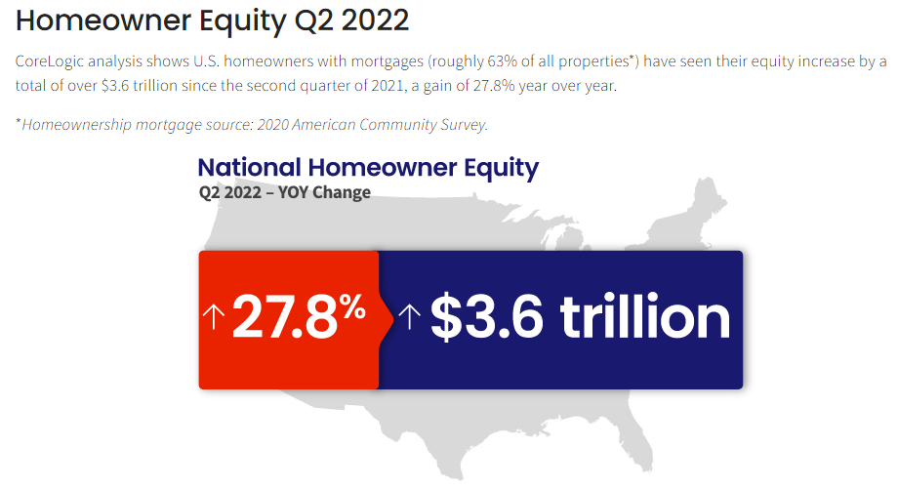
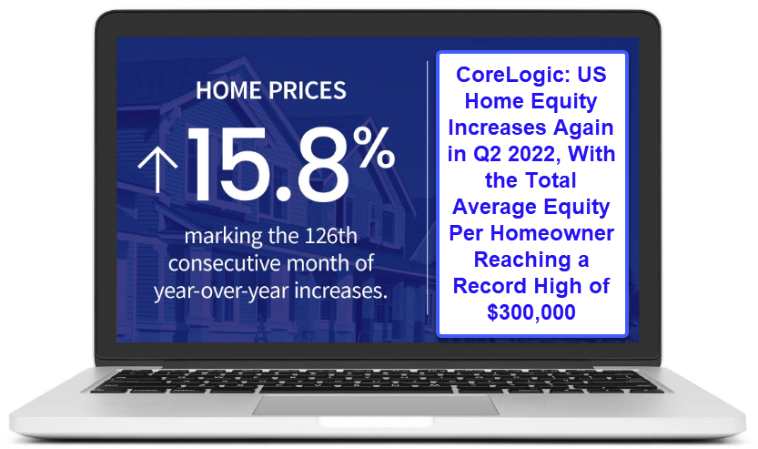
Why Now?
Home Equity Growth
Q2 2022 saw 27.8% increase in Home Equity YOY
Home Price Appreciation & Demand
Continued Double Digit HPI increases and Record High Average Equity Increase!
13
© Spring EQ, LLC 2022, All Rights Reserved
Notes:
According to Corelogic data, Homeowners Equity increased almost 28% or $3.6 Trillion dollars when comparing the 2nd Quarter of 2021 to the 2nd Quarter of 2022. Core Logic, along with many other industry experts, expects home price increases to normalize in 2023, but still stay positive.
Home price appreciation has continued to see double digit growth through Q2 of 2022, and while that is projected to slow, expectations is to still stay positive.
In Q2 of 2022, the average Equity per homeowner was estimated at nearly $300,000, a record high.

Slide 14
Why Now?
HI - $130,000
CA - $117,000
FL - $100,000
AZ - $89,000
NV - $82,000
WA - $82,000
CO - $76,000
UT - $71,000
NC - $70,000
TN - $69,000
Notes:
Core Logic shows these 10 states as the highest in YOY gain.

Slide 15
Why Now?
Notes:
According to Property Data Provider - ATTOM, this visual shows a State by State map of “Equity Rich” Homes in the 2nd Quarter of 2022, which represents the percentage of homeowners in each state that have an LTV of 50% or below, reporting that Nationwide, 48% of homeowners are at 50% or less in their LTV

Slide 16
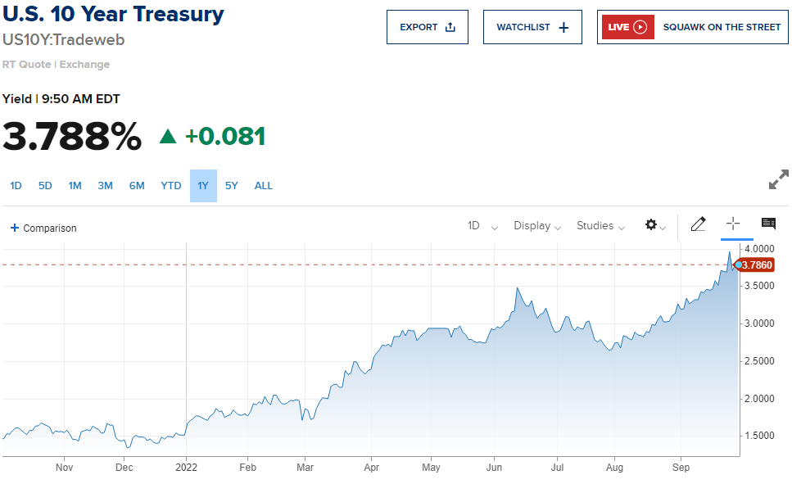
Why Now?

Slide 17
Why Now?
Notes:
historical graph of the 30 year fixed rate mortgage average - compiled by the St Louis Fed using Freddie Mac data.

Slide 18
Why Cash Out?
30 Year Fixed Rate Mortgage Average

Slide 19
Why Now?
Homeowners are staying in their homes 3 years longer…
Notes:
Data from NAR, which is the National Association of Realtors and US Census Bureau shows that in 2018 homeowners stayed in their homes for 13 years, this increased to 16 years in 2021.
This represents a 23% increase.
Current projections has this increasing even more due to the current environment.

Slide 20
Email Your Questions to:
askspring@springeq.com

Slide 21
Why Spring EQ?
Earn Compensation on Home Equity Loans!!!
Spring EQ is one of the very few lenders that allows you to earn up to 2% on all programs, both HELOC and HELOANs.
Incremental income to replace the lost refinance revenue!

Slide 22
Why Spring EQ?
Earn Compensation on Home Equity Loans!!!
HOW COMPENSATION IS PAID ON…
HOW COMPENSATION IS PAID ON…
HELOCS
Adjustable Rate Line-of-Credit
HELOANS
Fixed Rate Loan
Borrower Paid Compensation (BPC) is available
Borrower Paid Compensation (BPC) or Lender Paid
BPC is paid on the draw amount, not the total line of credit
BPC – you can charge $0 up to the compensation amount agreement on file
You can charge from $0 up to the compensation agreement on file
LPC – your fee is paid by Spring EQ and must equal your compensation amount agreement on file

Slide 23
Why Spring EQ?

Slide 24
Why Spring EQ?

Slide 25
In Summary
Home Equity Loans – Use the Equity built up in your home
Why Cash Out – Best option to tap into that equity for life events, such as debt consolidation, home improvement, investment purposes, etc.
Why Now – Record levels of built up equity, rising 1st mortgage rates, homeowners staying in their homes longer
Why Spring EQ – This is all we do, and have been doing it for years, offering the broadest product offerings in the industry.
25
© Spring EQ, LLC 2022, All Rights Reserved

Slide 26
To Become A Partner, Visit Our Website At: www.wholesale.springeq.com/become-a-partner For More Info About Spring EQ, Visit Our Website At: www.wholesale.springeq.com or call us at: 888-605-2588
Thank you for joining
We want to partner with you!

Slide 27
Appendix A – Data Sources
Slide 7 - St Louis Fed- Owner’s Equity - Households; Owners' Equity in Real Estate, Level (OEHRENWBSHNO) | FRED | St. Louis Fed (stlouisfed.org)
Slide 8 - Black Knight – prepay data - https://www.blackknightinc.com/
Slide 17 - St Louis Fed – Historical rates https://fred.stlouisfed.org/series/MORTGAGE30US
Slide 14 – CoreLogic - https://www.corelogic.com/press-releases/corelogic-us-home-equity-increases-again-in-q2-2022-with-the-total-average-equity-per-homeowner-reaching-a-record-high-of-300000/
Slide 13 CoreLogic- https://www.corelogic.com/intelligence/u-s-home-price-insights-september-2022/
Slide 15 – ATTOM - https://www.bloomberg.com/news/articles/2022-08-04/almost-half-of-u-s-mortgaged-homes-now-considered-equity-rich
Slide 16 - https://www.cnbc.com/quotes/US10Y
Slide 19- http://www.nar.realtor/ https://ipropertymanagment.com/research/average-lengthofhomewnershp

